Slide 1






Foundations of
Quantum Information Science (QIS 101)
Dave Biersach
Brookhaven National Laboratory
dbiersach@bnl.gov
Session 11
Complex Algebra

Slide 2
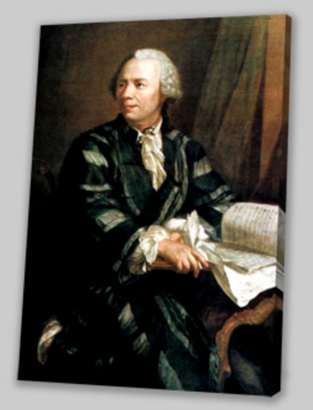
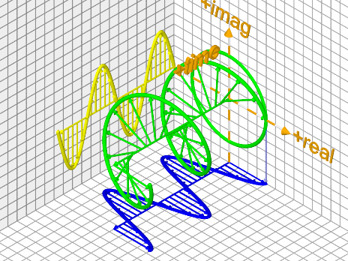
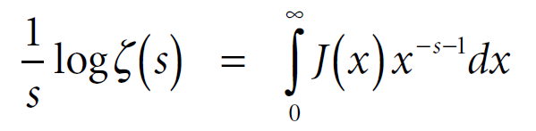
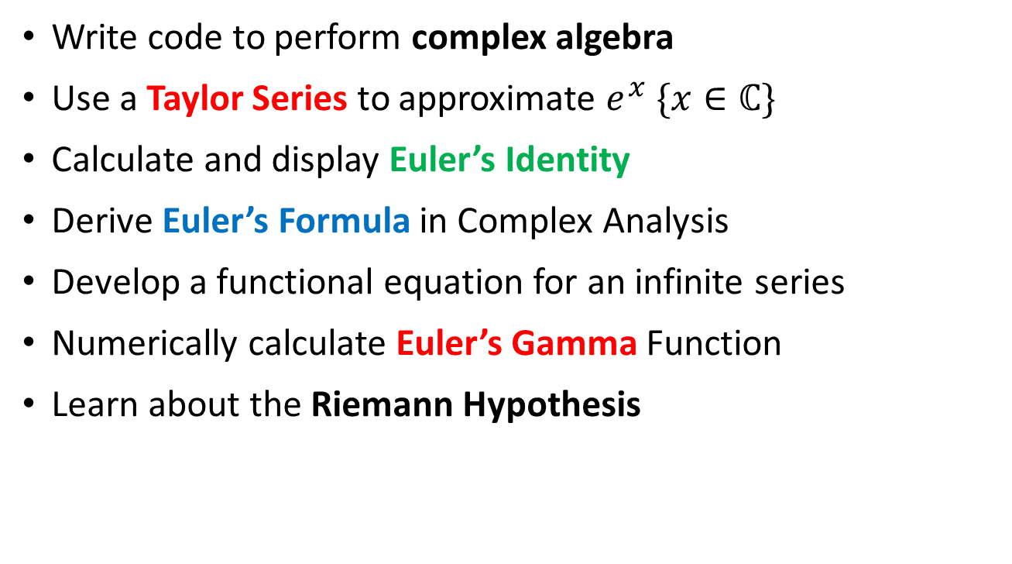
Session 11 – Goals
Write code to perform complex algebra
Use a Taylor Series to approximate $e^{x} \{x∈ℂ\}$
Calculate and display Euler’s Identity
Derive Euler’s Formula in Complex Analysis
Develop a functional equation for an infinite series
Numerically calculate Euler’s Gamma Function
Learn about the Riemann Hypothesis

Slide 3
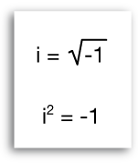
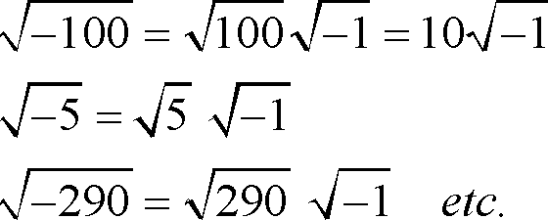
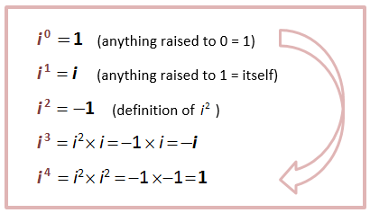
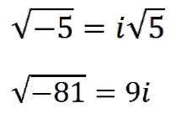
Complex Numbers

Slide 4
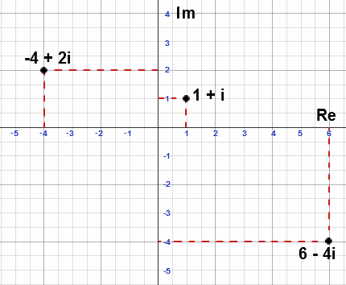
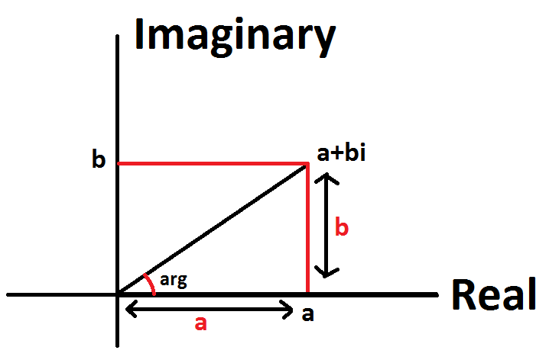
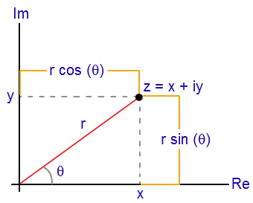
Complex Numbers
Argand
Diagram

Slide 5
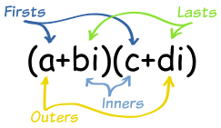
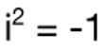
Complex Algebra
Sum:
$$\left(4+3i\right)+\left(5−4i\right)=\left(4+5\right)+\left(3−4\right)i$$
$$=9−i$$
Difference:
$$\left(4+3i\right)−\left(5−4i\right)=\left(4−5\right)+\left(3−\left(−4\right)\right)i$$
$$=−1+7i$$
Product:
$$\left(4+3i\right)\left(5−4i\right)=20−16i+15i−12i^{2}$$
$$=20−i+12$$
$$=32−i$$

Slide 6
Complex Algebra
Division:
$$\frac{\left(4+3i\right)}{\left(5−4i\right)}$$
$$\frac{\left(4+3i\right)}{\left(5−4i\right)}=\frac{\left(4+3i\right)}{\left(5−4i\right)}×\frac{\left(5+4i\right)}{\left(5+4i\right)}=\frac{\left(8+31i\right)}{41}$$
Complex Conjugate
$$=\frac{8}{41}+\frac{31}{41}i$$

Slide 7
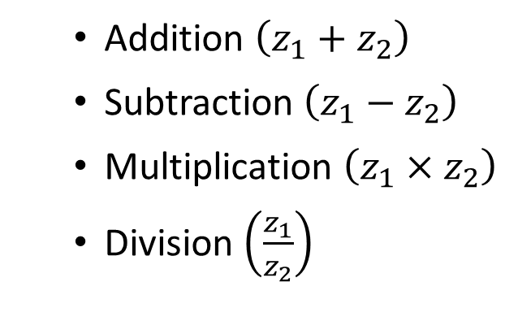
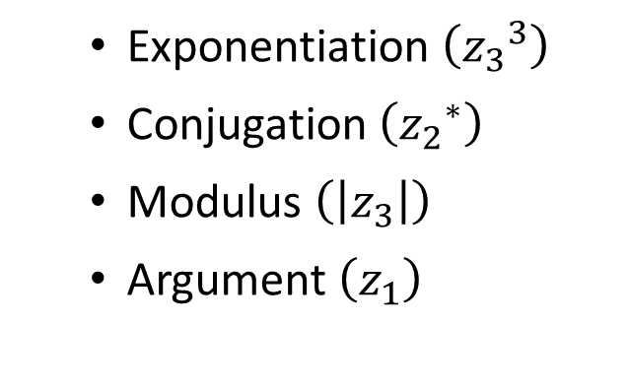
Complex Algebra
Given $z_{1}, z_{2}{,z}_{3}∈ℂ$
write Python code to display:
Addition $\left(z_{1}+z_{2}\right)$
Subtraction $\left(z_{1}−z_{2}\right)$
Multiplication $\left(z_{1}×z_{2}\right)$
Division $\left(\frac{z_{1}}{z_{2}}\right)$
Exponentiation $\left({z_{3}}^{3}\right)$
Conjugation $\left({z_{2}}^{∗}\right)$
Modulus $\left(\left|z_{3}\right|\right)$
Argument $\left(z_{1}\right)$

Slide 8


Complex Algebra

Slide 9


Using Jupyter Lab
https://jupyter.org

Slide 10
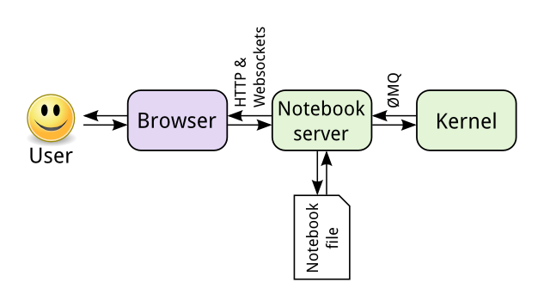
Using Jupyter Lab

Slide 11
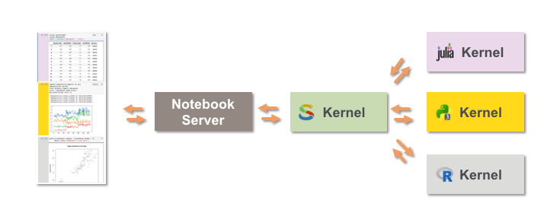
Using Jupyter Lab

Slide 12

Using Jupyter Lab
https://www.youtube.com/watch?v=HJgX1WWC26A
https://www.youtube.com/watch?v=FSdIoJdSnig

Slide 13
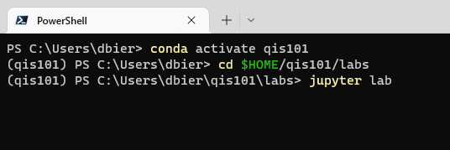
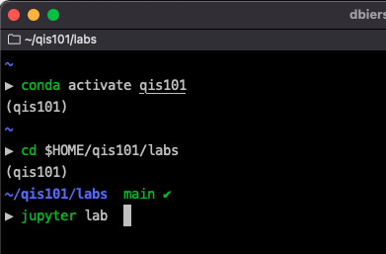
Start Jupyter Lab
conda activate qis101
cd $HOME/qis101/labs
jupyter lab

Slide 14
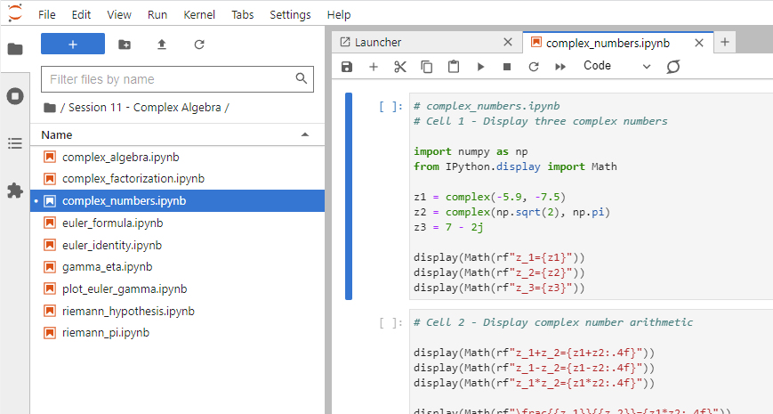
Open complex_numbers.ipynb
①
②
③
④
⑤
⑥

Slide 15
Run Cell 1 – complex_numbers.ipynb

Slide 16
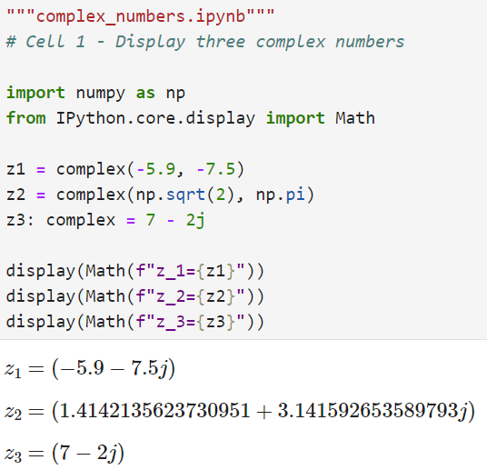
Run Cell 1 – complex_numbers.ipynb
With IPython.display.Math() we don't need to encapsulate LaTeX strings within a matching $ $ pair
①
②
③
①
②
③

Slide 17
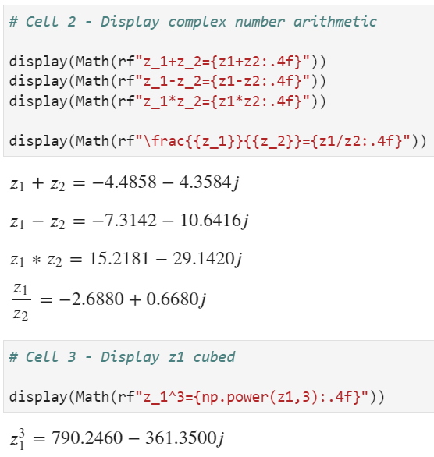
Run Cells 2 - 3
①
①
②
②

Slide 18
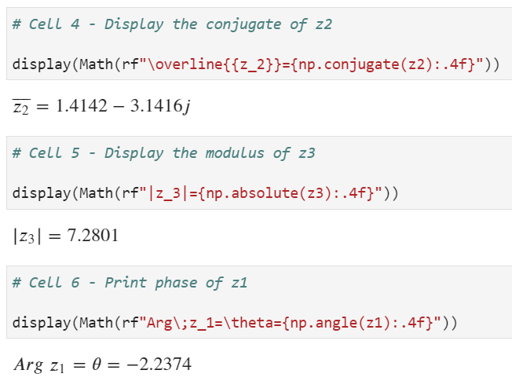
Run Cells 4 - 6
①
①
②
②
③
③

Slide 19
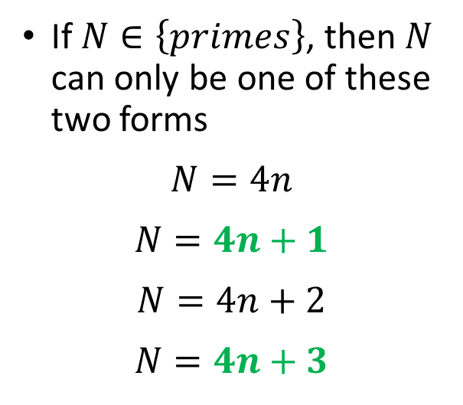

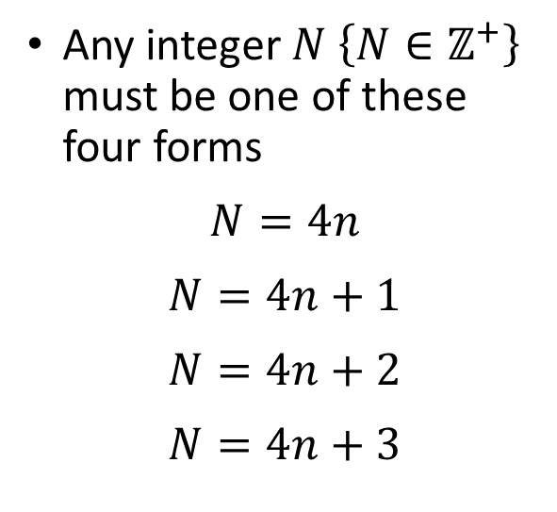
Representation Theory
Any integer $N \left\{N∈ℤ^{+}\right\}$ must be one of these four forms
$$N=4n$$
$$N=4n+1$$
$$N=4n+2$$
$$N=4n+3$$
If $N∈\left\{primes\right\}$, then $N$ can only be one of these two forms
$$N=4n$$
$$N=4n+1$$
$$N=4n+2$$
$$N=4n+3$$
$$N prime⇒N \% 4=\left\{1, 3\right\}$$

Slide 20
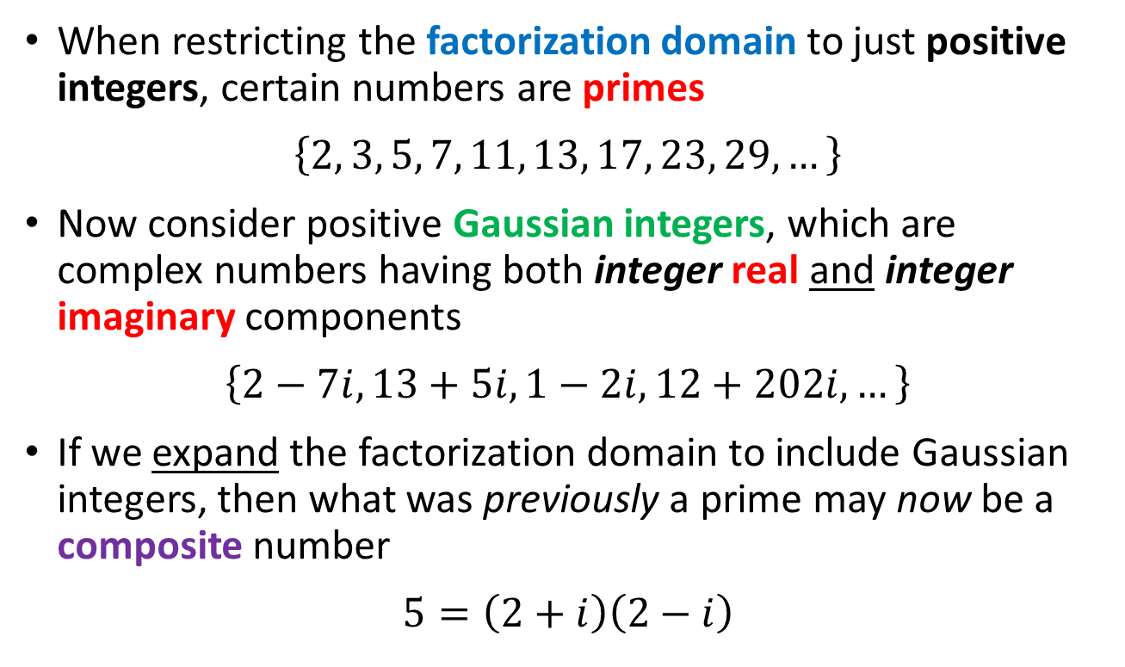
Unique Factorization Domains
When restricting the factorization domain to just positive integers, certain numbers are primes
$$\left\{2, 3, 5, 7, 11, 13, 17, 23, 29,…\right\}$$
Now consider positive Gaussian integers, which are complex numbers having both integer real and integer imaginary components
$$\left\{2−7i, 13+5i, 1−2i, 12+202i, …\right\}$$
If we expand the factorization domain to include Gaussian integers, then what was previously a prime may now be a composite number
$$5=\left(2+i\right)\left(2−i\right)$$

Slide 21
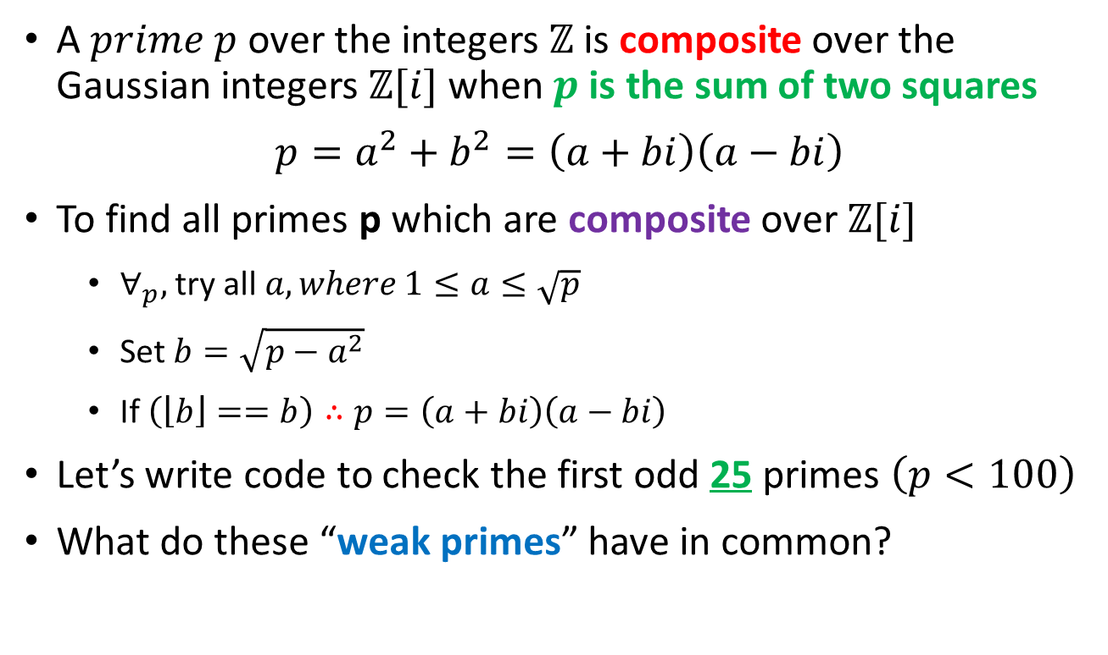
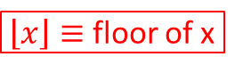
Unique Factorization Domains
A $prime p$over the integers $ℤ$is composite over the Gaussian integers $ℤ[i]$ when $p$ is the sum of two squares
$$p=a^{2}+b^{2}=\left(a+bi\right)\left(a−bi\right)$$
To find all primes p which are composite over $ℤ[i]$
$∀_{p},$ try all $a,where 1≤a≤\sqrt{p}$
Set $b=\sqrt{p−a^{2}}$
If $\left(\left\lfloor b\right\rfloor ==b\right)∴p=\left(a+bi\right)\left(a−bi\right)$
Let’s write code to check the first odd 25 primes $\left(p<100\right)$
What do these “weak primes” have in common?
$\left\lfloor x\right\rfloor ≡$ floor of x

Slide 22
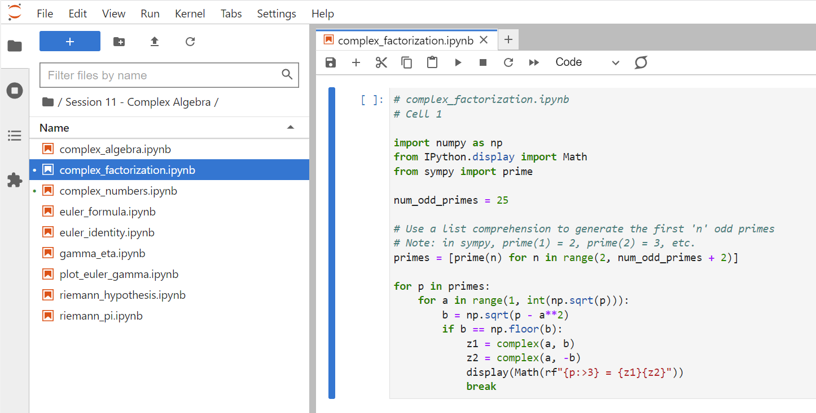
Open complex_factorization.ipynb
①
②
③
④
⑤
⑥

Slide 23
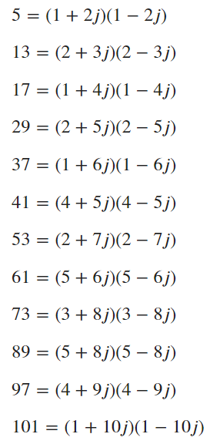
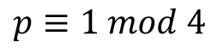
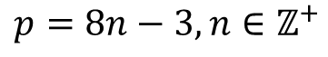
Run Cell 1 - complex_factorization.ipynb
What do these "weak primes" have in common?
$$p=8n−3,n∈ℤ^{+}$$
$$p≡1 mod 4$$

Slide 24
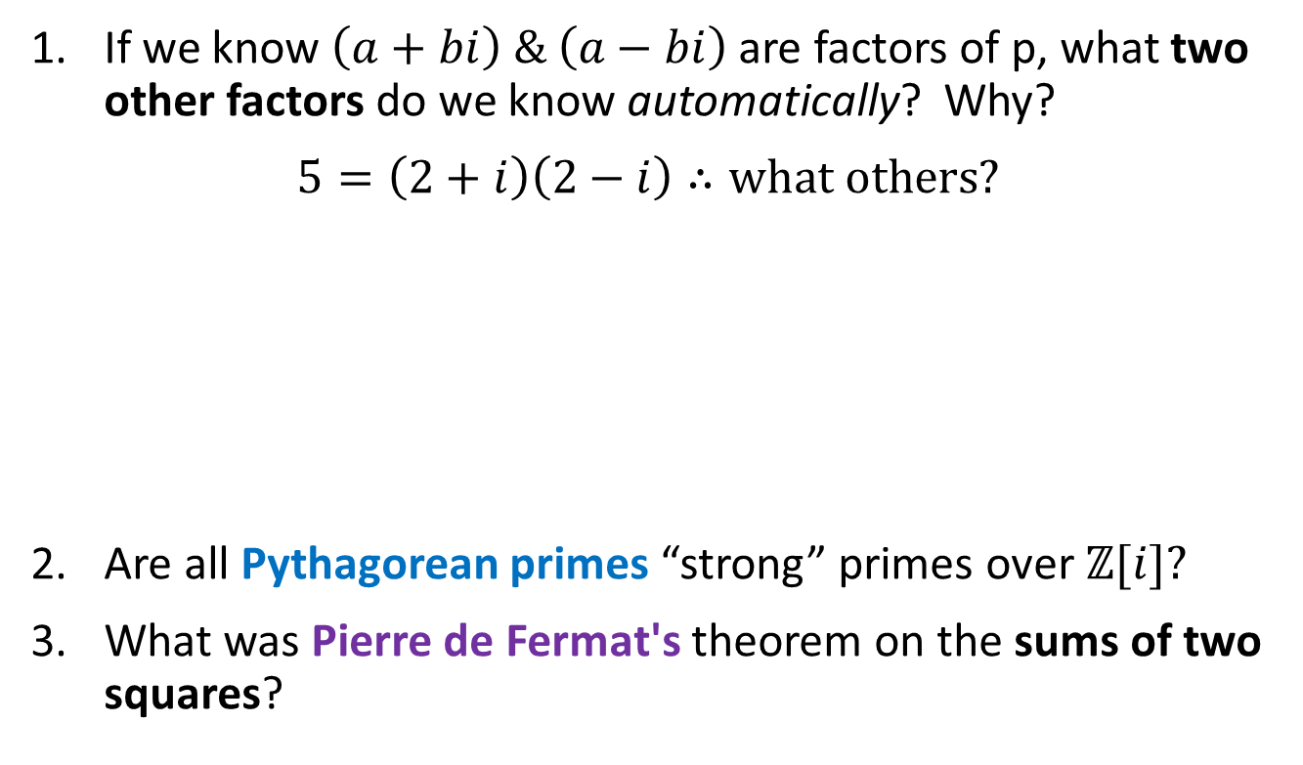
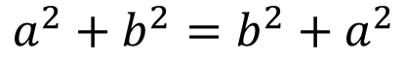

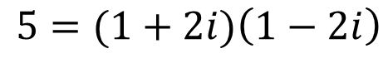

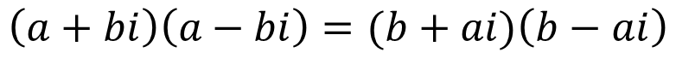
Research Questions
If we know $\left(a+bi\right) \& \left(a−bi\right)$ are factors of p, what two other factors do we know automatically? Why?
$$5=\left(2+i\right)\left(2−i\right)∴what others?$$
Are all Pythagorean primes “strong” primes over $ℤ[i]?$
What was Pierre de Fermat's theorem on the sums of two squares?
$$a=2$$
$$\left(a+bi\right)\left(a−bi\right)=(b+ai)\left(b−ai\right)$$
$$b=1$$
$$a^{2}+b^{2}=b^{2}+a^{2}$$
$$5=(1+2i)\left(1−2i\right)$$

Slide 25
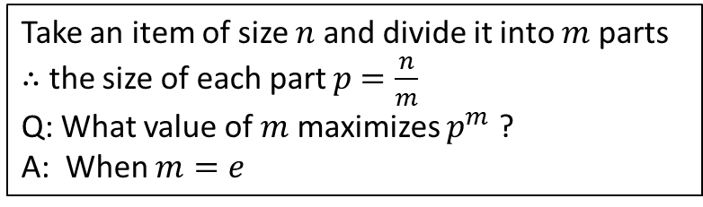

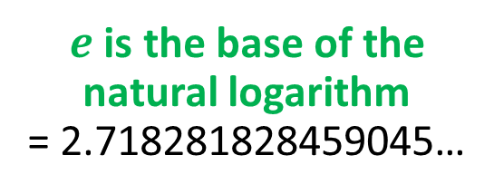
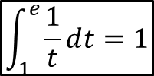
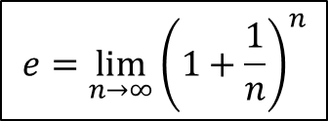
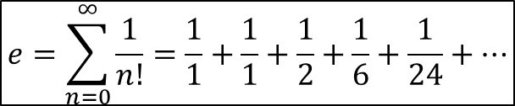

Why is $e$ so special?
Take an item of size $n$ and divide it into $m$ parts
$∴$ the size of each part $p$ $=\frac{n}{m}$
Q: What value of $m$ maximizes $p^{m}$ ?
A: When $m=e$
$$e=\sum_{n=0}^{∞}{\frac{1}{n!}=\frac{1}{1}+\frac{1}{1}+\frac{1}{2}+\frac{1}{6}+\frac{1}{24}+…}$$
$$e=\lim_{n→∞}{{\left(1+\frac{1}{n}\right)}^{n}}$$
$e$ is the base of the natural logarithm
= 2.718281828459045…
$$\int_{1}^{e}{\frac{1}{t}ⅆt=1}$$
$$\ln{e}=1$$

Slide 26
Why is $e$ so special?
$c≡$ a constant
$${ce}^{x}=c+cx+\frac{cx^{2}}{2!}+\frac{cx^{3}}{3!}+\frac{cx^{4}}{4!}+\frac{cx^{5}}{5!}+\frac{cx^{6}}{6!}+\frac{cx^{7}}{7!}+…$$
$\frac{d}{dx}\left(ce^{x}\right)=\frac{d}{dx}\left(c\right)+\frac{d}{dx}\left(cx\right)+\frac{d}{dx}\left(\frac{{cx}^{2}}{2!}\right)+\frac{d}{dx}\left(\frac{{cx}^{3}}{3!}\right)+…$
$$\frac{d}{dx}\left({ce}^{x}\right)=0+c+cx+\frac{cx^{2}}{2!}+\frac{x^{3}}{3!}+\frac{x^{4}}{4!}+\frac{x^{5}}{5!}+\frac{x^{6}}{6!}+\frac{x^{7}}{7!}+…$$
$$\frac{d}{dx}\left(ce^{x}\right)={ce}^{x}$$
${ce}^{x}$is the only function which is the derivative of itself !

Slide 27
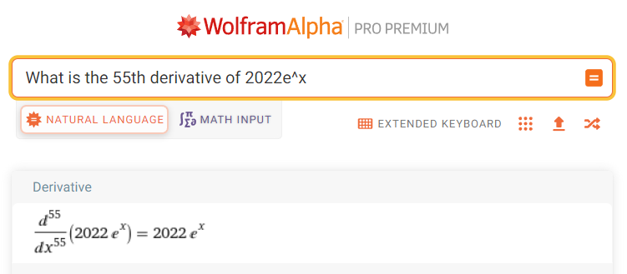


Why is $e$ so special?
$c≡$ a constant
$$\frac{d}{dx}\left(ce^{x}\right)={ce}^{x}$$
${ce}^{x}$is the only function which is the derivative of itself !

Slide 28
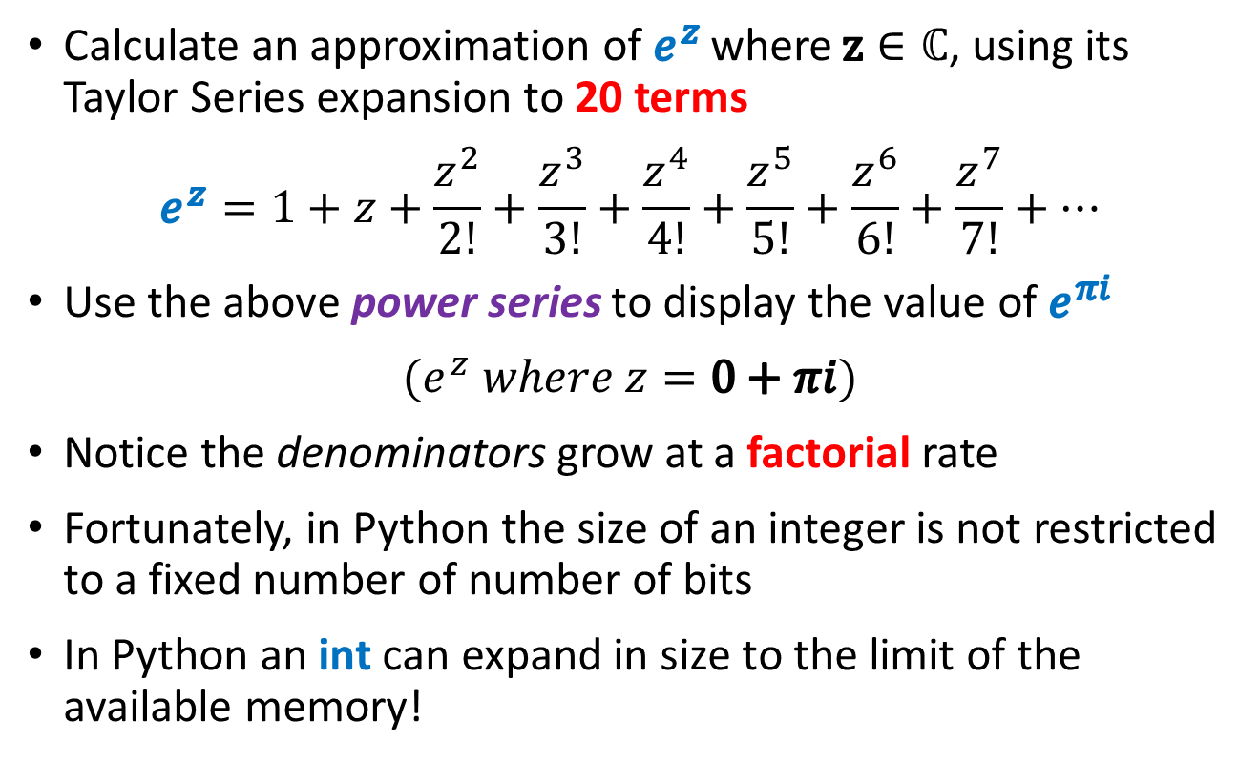
Euler’s Identity
Calculate an approximation of $e^{z}$ where $z∈ℂ$, using its Taylor Series expansion to 20 terms
$$e^{z}=1+z+\frac{z^{2}}{2!}+\frac{z^{3}}{3!}+\frac{z^{4}}{4!}+\frac{z^{5}}{5!}+\frac{z^{6}}{6!}+\frac{z^{7}}{7!}+…$$
Use the above power series to display the value of $e^{πi}$
$$(e^{z} where z=0+πi)$$
Notice the denominators grow at a factorial rate
Fortunately, in Python the size of an integer is not restricted to a fixed number of number of bits
In Python an int can expand in size to the limit of the available memory!

Slide 29
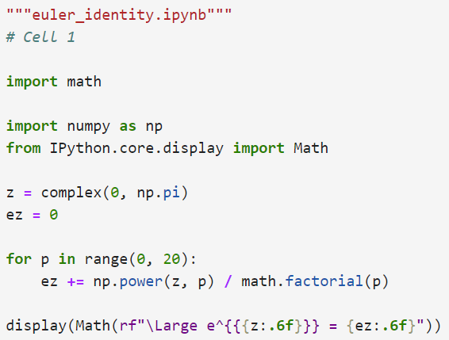
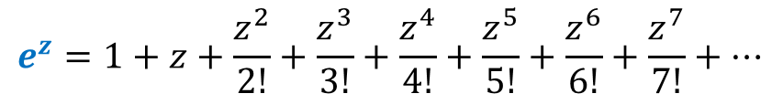
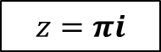
Open euler_identity.ipynb
①
②
$$z=πi$$
③
④
⑤
⑥

Slide 30
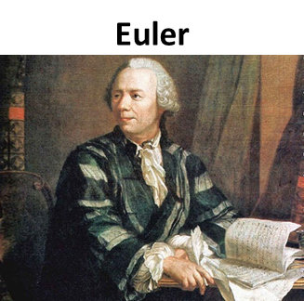
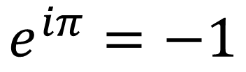
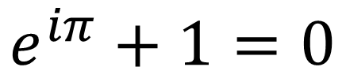
Run euler_identity.ipynb
$$e^{iπ}=−1$$
$$e^{iπ}+1=0$$

Slide 31
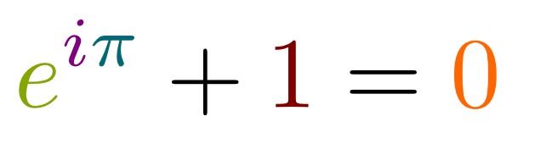

Euler’s Identity

Slide 32
$$−1=e^{πi}$$
$$i^{i}= ?$$
$${\left(−1\right)}^{\frac{1}{2}}={\left(e^{πi}\right)}^{\frac{1}{2}}$$
$$\sqrt{−1}=e^{\frac{πi}{2}}$$
$${\left(a^{b}\right)}^{c}=a^{bc}$$
$${\left(2^{3}\right)}^{4}=2^{3×4}=2^{12}$$
$$i=e^{\frac{πi}{2}}$$
$$i^{i}={\left(e^{\frac{πi}{2}}\right)}^{i}$$
$$e^{πi}=−1$$
$$i^{i}=e^{\frac{πi^{2}}{2}}$$
$$i^{i}=e^{\frac{−π}{2}}$$
$i^{i}≅0.20787∈ℝ$

Slide 33
Euler’s Formula
Img
Use the chain rule!
$$z=\cos{θ}+i\sin{θ}$$
$$\frac{d}{dθ}\left(e^{iθ}\right)=ie^{iθ}$$
1
$$\frac{d^{2}}{dθ^{2}}\left(e^{iθ}\right)=−e^{iθ}$$
$$θ$$
Re
$$e^{iθ}=\cos{θ}+i\sin{θ}$$
Euler’s Formula
$$\frac{dz}{dθ}=−\sin{θ+i\cos{θ}}$$
$$\frac{d^{2}z}{dθ^{2}}=−\cos{θ−i\sin{θ}}$$
$$\frac{dz}{dθ}=i\left(\cos{θ}+i\sin{θ}\right)=iz$$
$$\frac{d^{2}z}{dθ^{2}}=i^{2}\left(\cos{θ}+i\sin{θ}\right)=i^{2}z=−z$$

Slide 34
Euler's Formula
$$\cos{x}=1−\frac{x^{2}}{2!}+\frac{x^{4}}{4!}−\frac{x^{6}}{6!}+\frac{x^{8}}{8!}+…$$
$$\sin{x}=x−\frac{x^{3}}{3!}+\frac{x^{5}}{5!}−\frac{x^{7}}{7!}+\frac{x^{9}}{9!}+…$$
$$e^{x}=1+x+\frac{x^{2}}{2!}+\frac{x^{3}}{3!}+\frac{x^{4}}{4!}+\frac{x^{5}}{5!}+\frac{x^{6}}{6!}+\frac{x^{7}}{7!}…$$
$$e^{ix}=1+ix+\frac{{\left(ix\right)}^{2}}{2!}+\frac{{\left(ix\right)}^{3}}{3!}+\frac{{\left(ix\right)}^{4}}{4!}+\frac{{\left(ix\right)}^{5}}{5!}+\frac{{\left(ix\right)}^{6}}{6!}+\frac{{\left(ix\right)}^{7}}{7!}+…$$
$$e^{ix}=1+ix−\frac{x^{2}}{2!}−i\frac{x^{3}}{3!}+\frac{x^{4}}{4!}+i\frac{x^{5}}{5!}−\frac{x^{6}}{6!}−i\frac{x^{7}}{7!}+……$$
$$e^{ix}=\left(1−\frac{x^{2}}{2!}+\frac{x^{4}}{4!}−\frac{x^{6}}{6!}\right)+i\left(x−\frac{x^{3}}{3!}+\frac{x^{5}}{5!}−\frac{x^{7}}{7!}\right)+…$$
$$e^{ix}=\cos{x}+i\sin{x}$$

Slide 35

Euler’s Formula
The difference between $e^{x}$ and $e^{ix}$
Complex exponentials wave!
$$\cos{θ}$$
$$\sin{θ}$$

Slide 36




Open euler_formula.ipynb
①
⑤
②
③
$$−10≤x≤10$$
④
⑥
⑦
⑧
⑨
⑩

Slide 37

View euler_formula.ipynb
①
Convert complex exponential to Argand coordinates
②
③
④
⑤
⑥
⑦
⑧

Slide 38

View euler_formula.ipynb
①
Convert Argand coordinates to complex exponential
②
③
④
⑤
⑥
⑦
⑧
⑨

Slide 39




Run euler_formula.ipynb
$$−10≤x≤10$$
$$−10≤θ≤10$$
$e^{x}$ is just a limitless rising curve
$e^{iθ}$ keeps looping, forever locked in a unit circle

Slide 40

Run euler_formula.py
Point 1
Complex Exponential to
Argand Coordinates
$$−10≤x≤10$$
$$θ$$
$$\sqrt{{\left(−1\right)}^{2}+{\left(−1.5\right)}^{2}}=\sqrt{3.25}=1.803$$
$$θ=2\tan^{−1}\left(\frac{−1.5}{−1+\sqrt{3.25}}\right)=−2.159$$
Point 2
Argand Coordinates to
Complex Exponential

Slide 41


Euler’s Formula
$$e^{iθ}=\cos{θ}+i\sin{θ}$$
$$e^{iθ}=\cos{θ}+i\sin{θ}$$
$$+$$
$$−$$
$$e^{−iθ}=\cos{θ}−i\sin{θ}$$
$$e^{−iθ}=\cos{θ}−i\sin{θ}$$
$$e^{iθ}+e^{−iθ}=2cos{θ}$$
$$e^{iθ}−e^{−iθ}=2i\sin{θ}$$
$$\cos{θ}=\frac{e^{iθ}+e^{−iθ}}{2}$$
$$\sin{θ}=\frac{e^{iθ}−e^{−iθ}}{2i}$$
$$\sin{0}=0$$
$$\cos{0=1}$$

Slide 42
$$\sqrt{i}+\sqrt{−i}= ?$$
$$e^{iθ}=\cos{θ+i\sin{θ}}$$
$$\left(\cos{\frac{π}{4}+i\sin{\frac{π}{4}}}\right)+\left(\cos{\frac{−π}{4}+i\sin{\frac{−π}{4}}}\right)$$
$$e^{\frac{π}{2}i}=i$$
$$e^{\frac{−π}{2}i}=−i$$
$$\left(\frac{1}{\sqrt{2}}+\frac{i}{\sqrt{2}}\right)+\left(\frac{1}{\sqrt{2}}+\frac{−i}{\sqrt{2}}\right)$$
$$\sqrt{e^{\frac{π}{2}i}}+\sqrt{e^{\frac{−π}{2}i}}$$
$$\frac{1}{\sqrt{2}}+\frac{1}{\sqrt{2}}=\frac{2}{\sqrt{2}}=\sqrt{2}$$
$${\left(e^{\frac{π}{2}i}\right)}^{\frac{1}{2}}+{\left(e^{\frac{−π}{2}i}\right)}^{\frac{1}{2}}$$
$$\sqrt{i}+\sqrt{−i}=\sqrt{2}$$
$e^{\frac{π}{4}i}+$ $e^{\frac{−π}{4}i}$

Slide 43







Complex Numbers
$$z=5+2i$$
We use the conjugate because the inner product must be $∈ℝ≥0$
$$\overline{z}=5−2i$$
$$z∙\overline{z}=\left(5+2i\right)\left(5−2i\right)$$
$$=\left(5⋅5\right)+\left(5⋅−2i\right)+\left(2i⋅5\right)+\left(2i⋅−2i\right)$$
$$=29$$
$$\left|z\right|=\sqrt{z∙\overline{z}}=\sqrt{29}=\left\|z\right\|$$
For complex numbers (scalars):
the magnitude $=$
the norm $\left\|z\right\|=$
the absolute value $\left|z\right|$

Slide 44








Complex Number Identities
$$\left|c_{1}\right|\left|c_{2}\right|=\left|c_{1}c_{2}\right|$$
①
$$e^{i\left(θ_{1}+θ_{2}\right)}=\left(e^{iθ_{1}}\right)\left(e^{iθ_{2}}\right)$$
⑤
②
$$θ=argument$$
$$\left|c_{1}{+c}_{2}\right|≤\left|c_{1}\right|+\left|c_{2}\right|$$
$$c^{\frac{1}{n}}=\sqrt[n]{\left|c\right|}e^{\frac{θ+2πk}{n}i}$$
⑥
$$\overline{c_{1}}+\overline{c_{2}}=\overline{c_{1}+c_{2}}$$
③
Let's look at how to demonstrate these six identities using Python (Jupyter Lab + LaTeX)
$$\overline{c_{1}}⋅\overline{c_{2}}=\overline{c_{1}⋅c_{2}}$$
④
$$e^{i\left(θ_{1}+θ_{2}\right)}=\cos\left(θ_{1}+θ_{2}\right)+i\sin\left(θ_{1}+θ_{2}\right)$$
$$=\left(\cos{θ_{1}}\cos{θ_{2}}−\sin{θ_{1}}\sin{θ_{2}}\right)+i\left(\sin{θ_{1}}\cos{θ_{2}}+\sin{θ_{2}}\cos{θ_{1}}\right)$$
A Proof
$$=\left(\cos{θ_{1}}+i\sin{θ_{1}}\right)\left(\cos{θ_{2}}+i\sin{θ_{2}}\right)$$
$$=\left(e^{iθ_{1}}\right)\left(e^{iθ_{2}}\right)$$

Slide 45


Open complex_algebra.ipynb
①
②
③
t1
t2
④
Identity # 1:
$$\left|c_{1}\right|\left|c_{2}\right|=\left|c_{1}c_{2}\right|$$
⑤
⑥
t1 = Left-Hand Side of Equation (the first term)
t2 = Right-Hand Side of Equation (the second term)

Slide 46


Run Cell 1 – complex_algebra.ipynb
$$\left|c_{1}\right|\left|c_{2}\right|=\left|c_{1}c_{2}\right|$$
①
We will use np.isclose() very often

Slide 47






Run Cells 2 & 3 – complex_algebra.ipynb
$$\left|c_{1}{+c}_{2}\right|≤\left|c_{1}\right|+\left|c_{2}\right|$$
②
②
$$\overline{c_{1}}+\overline{c_{2}}=\overline{c_{1}+c_{2}}$$
③
③

Slide 48



Run Cell 4 – complex_algebra.ipynb
④
$$\overline{c_{1}}⋅\overline{c_{2}}=\overline{c_{1}⋅c_{2}}$$
④

Slide 49







Run Cell 5 – complex_algebra.ipynb
$$+i$$
⑤
$$θ_{1}={67.5}^{°}$$
$$θ_{2}={22.5}^{°}$$
$$θ_{2}$$
$$θ_{1}$$
$$+1$$
Complex Multiplication is Rotation
(Angular Addition)
Roundoff errors are common

Slide 50












Run Cell 6 – complex_algebra.ipynb
t1
t2
$$θ=argument$$
$$c^{\frac{1}{n}}=\sqrt[n]{\left|c\right|}e^{\frac{θ+2πk}{n}i}$$
⑥
$5^{th}$ Roots of Unity
$$\left(0.31+0.95j\right)$$
$$\left(−.81+0.59j\right)$$
$$θ$$
$$\left(1+0j\right)$$
$$\left(−.81−0.59j\right)$$
$$\left(0.31−0.95j\right)$$

Slide 51
Functional Equations
Consider the following series:
$$M_{n}\left(x\right)=1+x+x^{2}+x^{3}+…+x^{n}=\sum_{k=0}^{n}{x^{k}}$$
For example:$M_{2}\left(x\right)=1+x+x^{2}$
As $n→∞$ such that $M\left(x\right)=\sum_{k=0}^{∞}{x^{k}}$, what is the domain interval where $M(x)$ converges?
$M\left(1\right)=1+1+1+1+…=∞$ (diverges)
$M\left(0\right)=1+0+0+0+…=1$ (converges)
What about $M\left(−1\right)?$

Slide 52
Functional Equations
$$M\left(−1\right)=1+\left(−1\right)+{\left(−1\right)}^{2}+{\left(−1\right)}^{3}+{\left(−1\right)}^{4}+…=?$$
$$M_{5}(−1)=(1−1)+(1−1)+(1−1)=0$$
$$M_{6}(−1)=\left(1−1\right)+\left(1−1\right)+\left(1−1\right)+1=1$$
$$μ=\frac{(M_{5}+M_{6})}{2}=\frac{(0+1)}{2}=\frac{1}{2}∴M\left(−1\right)=0.5 ?$$
Note: This approach of adding partial terms of a series is called Cesàro summation

Slide 53
Functional Equations
$$M_{2}\left(x\right)\left(1−x\right)=\left(1\right)\left(1−x\right)+\left(x\right)\left(1−x\right)+\left(x^{2}\right)\left(1−x\right)$$
$$M_{2}\left(x\right)\left(1−x\right)=1−x+x−x^{2}+x^{2}−x^{3}$$
$$M_{2}\left(x\right)\left(1−x\right)=1+\left(−x+x\right)+(−x^{2}+x^{2})−x^{3}$$
$$M_{2}\left(x\right)\left(1−x\right)=1−x^{3}$$
$$M_{2}\left(x\right)=\frac{1−x^{3}}{1−x}∴M\left(x\right)=\frac{1−x^{∞}}{1−x}=\frac{1−0}{1−x}\left\{x∈ℝ (−1,1)\right\}$$
$$\lim_{n→∞}{x^{n}=0⇔\left|x\right|<1}$$

Slide 54

Functional Equations
$$M\left(x\right)=\frac{1−x^{∞}}{1−x}=\frac{1}{1−x}⟺−1<x<1$$
$M\left(−1\right)=\frac{1}{1−(−1)}=\frac{1}{2}$ ?! (debatable as ${−1}^{∞}$ is undefined)
$$M\left(x\right)=1+x+x^{2}+…=\sum_{k=0}^{∞}{x^{k}}=\frac{1}{1−x} \left\{x∈ℝ (−1,1)\right\}$$
$M\left(x\right)=\frac{1}{1−x}$ is the functional equation for the infinite series only over the exclusive domain (-1, 1)
We no longer need to add a large (approximately infinite) number of terms to get the sum within that domain – we can use this equation as a shortcut!

Slide 55

A Functional Equation for the Factorial
Consider the classic factorial function:
$$n!=n∗\left(n−1\right)∗\left(n−2\right)∗\left(n−3\right)∗…∗1$$
$$5!=5 ∗4 ∗3 ∗2 ∗1=120$$
We wish to find a functional equation that provides a shortcut to compute the factorial without having to iterate through the product of every term
For an analogy, consider the closed form (analytic) Riemann Integral is the functional equation of an infinite sum of diminishing rectangular areas under a curve
Can we express the factorial function as an integral?

Slide 56
Euler’s Gamma Function
$$n!=Γ\left(n+1\right)$$
$$5!=Γ\left(6\right)=120$$
$$Γ\left(s\right)=\int_{0}^{∞}{x^{s−1}e^{−x}ⅆx} \left\{s∈ℂ, Re\left(s\right)>0\right\}$$
$$Γ\left(6\right)=\int_{0}^{∞}{x^{5}e^{−x}ⅆx}= ?$$

Slide 57
Euler’s Gamma Function
Differential Product Rule
$$\left[u\left(x\right)∗v\left(x\right)\right]\frac{d}{dx}=u\left(x\right)\frac{dv}{dx}+v\left(x\right)\frac{du}{dx}$$
$$\int{\left[u\left(x\right)∗v\left(x\right)\right]\frac{d}{dx}}=\int{u\left(x\right)\frac{dv}{dx}}+\int{v\left(x\right)\frac{du}{dx}}$$
$$uv=\int{u}dv+\int{v}du$$
$$\int{u}dv=uv−\int{v}du$$
Integration by Parts

Slide 58
Euler’s Gamma Function
$$Γ\left(6\right)=\int_{0}^{∞}{x^{5}e^{−x}ⅆx}$$
Recall integration by parts (from differential product rule)
$$\int{uⅆv=uv−\int{v}ⅆu}$$
$$u=x^{5},ⅆv=e^{−x}ⅆx$$
$$du={5x}^{4}dx,v={−e}^{−x}$$
$${\left.\left(x^{5}\right)\left({−e}^{−x}\right)\right|}_{0}^{∞}−\int_{0}^{∞}{({−e}^{−x}){(5x}^{4}dx)}$$

Slide 59
Euler’s Gamma Function
$${\left.\left(x^{5}\right)\left({−e}^{−x}\right)\right|}_{0}^{∞}−\int_{0}^{∞}{({−e}^{−x}){(5x}^{4}dx)}$$
$$\lim_{b→∞}{(b^{5})\left(−e^{−b}\right)}−\left(0^{5}\right)\left(−e^{−0}\right)=\lim_{b→∞}{\frac{b^{5}}{−e^{b}}=0}$$
$$−\int_{0}^{∞}{({−e}^{−x}){(5x}^{4}dx)}=5\int_{0}^{∞}{x^{4}e^{−x} dx}$$
$$Γ\left(6\right)=5\int_{0}^{∞}{x^{4}e^{−x} dx}= ?$$
$$Γ\left(6\right)=\int_{0}^{∞}{x^{5}e^{−x}ⅆx}$$

Slide 60
Euler’s Gamma Function
$$Γ\left(6\right)=5\int_{0}^{∞}{x^{4}e^{−x} dx}$$
$$Γ\left(6\right)=20\int_{0}^{∞}{x^{3}e^{−x} dx}$$
$$Γ\left(6\right)=60\int_{0}^{∞}{x^{2}e^{−x} dx}$$
$$Γ\left(6\right)=120\int_{0}^{∞}{x^{1}e^{−x} dx}$$
$$Γ\left(6\right)=120\int_{0}^{∞}{{x^{0}e}^{−x} dx}=(120)(1)$$
$$Γ\left(6\right)=120=5!$$

Slide 61
Euler’s Gamma Function
$$Γ\left(s\right)=\int_{0}^{∞}{x^{s−1}e^{−x}ⅆx} \left\{s∈ℂ, Re\left(s\right)>0\right\}$$
Realize the real Gamma function is just an integral that we can numerically compute using Simpson’s Rule
Let’s plot this integral over the domain of real numbers
We will first plot $Γ(s)$ from $0≤s≤5$ along with $y=s!$

Slide 62



Open plot_euler_gamma.ipynb
Imperative
Procedural
Declarative
Functional
①
②
③
④

Slide 63

View Cell 1 - plot_euler_gamma.ipynb
$$Γ\left(s\right)=\int_{0}^{∞}{x^{s−1}e^{−x}ⅆx}$$
$$if s=0 and x=0⟹ ??$$
④
⑤
③
②
①

Slide 64

View Cell 1 - plot_euler_gamma.ipynb
③
④
⑤
⑥
⑦
⑧
⑨
②
①

Slide 65

Run Cell 1 - plot_euler_gamma.ipynb
$$5!=Γ\left(6\right)=120$$
$$4!=Γ\left(5\right)=24$$
$$3!=Γ\left(4\right)=6$$

Slide 66


Run Cell 2 - plot_euler_gamma.ipynb
$$2!=Γ\left(3\right)=2$$
$$1!=Γ\left(2\right)=1$$
$$\frac{1}{2}!=Γ\left(1.5\right)≅0.886227…$$

Slide 67


Euler’s Gamma Function
Euler was a mathematical pathfinder – he liked to bend the rules and push the boundaries of existing functions
He asked, “what is the factorial of a fraction?”
He also asked, “what is the factorial of a negative number?”
We can clearly see in the plot that $\left(\frac{1}{2}\right)!<1$
But Euler went farther and proved these two gems:
$$\left(\frac{1}{2}\right)!=\frac{\sqrt{π}}{2}=0.8862269…$$
$$\left(−\frac{1}{2}\right)!=\sqrt{π}=1.7724538…$$

Slide 68

The Riemann Zeta Function
Recall the Harmonic Series:
$$\sum_{n=1}^{∞}{\frac{1}{n}=1+\frac{1}{2}+\frac{1}{3}+\frac{1}{4}+\frac{1}{5}+\frac{1}{6}+\frac{1}{7}+…}$$
Nicole Oresme proved this diverges to $∞$ in 1360
Recall the Basel Problem:
$$\sum_{n=1}^{∞}{\frac{1}{n^{2}}=1+\frac{1}{4}+\frac{1}{9}+\frac{1}{16}+\frac{1}{25}+\frac{1}{36}+\frac{1}{49}+…}$$
Euler proved this converged to $π/6$ in 1735

Slide 69

The Riemann Zeta Function
Bernhard Riemann considered in 1859 what happens to the series if we extend the domain beyond natural numbers to the complex domain – he used the Greek letter zeta:
$$ξ\left(s\right)=\sum_{n=1}^{∞}{\frac{1}{n^{s}}=1+\frac{1}{2^{s}}+\frac{1}{3^{s}}+\frac{1}{4^{s}}+…} s∈ℂ$$
He was trying to produce a functional equation (a shortcut) that would analytically determine the exact number of primes less than a given number without having to count each individual prime
This “prime counting function” is often expressed as $π(x)$
As an example: $π\left(1,000,000\right)=78,498$

Slide 70

The Dirichlet Eta Function
Riemann faced a problem because his Zeta function only converges for complex numbers with real part $>1$
Fortunately, a slight modification to Zeta helps it converge more easily. This helper is called the Eta function:
$$η\left(s\right)=\sum_{n=1}^{∞}{\frac{{(−1)}^{n−1}}{n^{s}}=1−\frac{1}{2^{s}}+\frac{1}{3^{s}}−\frac{1}{4^{s}}+\frac{1}{5^{s}}−\frac{1}{6^{s}}…}$$
The sign alternates between successive terms – all terms with an even $n$ are now subtracted
Eta converges for any complex number having real part $>0$

Slide 71

The Dirichlet Eta Function
Euler's Gamma function is closely related to Dirichlet's Eta
$$Γ\left(s\right)=\frac{1}{η\left(s\right)}\int_{0}^{∞}{\frac{x^{s−1}}{e^{x}+1}ⅆx}$$
So now we have yet another way to calculate $n!$
The mpmath package has a built-in function altzeta() that calculates $η\left(s\right)$ - it is so named because the Eta function alternates the signs of the Zeta function terms
We can use SciPy's integrate() function to calculate the integral
Let's calculate 5! using this alternate definition of $Γ\left(s\right)$

Slide 72


Open gamma_eta.ipynb
①
②
③
④
$$Γ\left(s\right)=\frac{1}{η\left(s\right)}\int_{0}^{∞}{\frac{x^{s−1}}{e^{x}+1}ⅆx}$$
⑤
⑥

Slide 73


View gamma_eta.ipynb
①
$$Γ\left(s\right)=\frac{1}{η\left(s\right)}\int_{0}^{∞}{\frac{x^{s−1}}{e^{x}+1}ⅆx}$$
②
③
④
⑤
⑥
⑦

Slide 74





Run gamma_eta.ipynb
Gamma via Eta:
Classic Factorial:
$$η\left(s\right)=\sum_{n=1}^{∞}{\frac{{(−1)}^{n−1}}{n^{s}}=1−\frac{1}{2^{s}}+\frac{1}{3^{s}}−\frac{1}{4^{s}}+\frac{1}{5^{s}}−\frac{1}{6^{s}}…}$$
$$Γ\left(s\right)=\frac{1}{η\left(s\right)}\int_{0}^{∞}{\frac{x^{s−1}}{e^{x}+1}ⅆx}$$
Bernhard Riemann
1826 – 1863
(39 years old)
Peter Gustav Lejeune Dirichlet
1805 – 1859

Slide 75

The Dirichlet Eta Function
The Eta function has some interesting values which you can write code to numerically compute:
$η\left(2\right)=\frac{π^{2}}{12}$ which is one-half of Euler’s Basel sum
$η\left(1\right)=\ln{2}$ which is called the alternating harmonic series
$η\left(0\right)=\frac{1}{2}$ which is the Abel sum of Grandi’s series
$η\left(0\right)=1 −1+1 −1+…=$ $\frac{1}{2} ??$ (see slide #52)
Fortunately, $η\left(s\right)$ helps us extend the domain of $ξ\left(s\right)$as Eta converges for complex numbers having a real part $>0$
But how can we find $ξ\left(s\right)$ if all we have is $η\left(s\right)$?

Slide 76
Zeta in terms of Eta
$$ξ\left(s\right)=1+\frac{1}{2^{s}}+\frac{1}{3^{s}}+\frac{1}{4^{s}}+\frac{1}{5^{s}}+\frac{1}{6^{s}}…$$
$$η\left(s\right)=1−\frac{1}{2^{s}}+\frac{1}{3^{s}}−\frac{1}{4^{s}}+\frac{1}{5^{s}}−\frac{1}{6^{s}}…$$
$$ξ\left(s\right)−η\left(s\right)=\frac{2}{2^{s}}+\frac{2}{4^{s}}+\frac{2}{6^{s}}+\frac{2}{8^{s}}+\frac{2}{{10}^{s}}…$$
$$ξ\left(s\right)−η\left(s\right)=\left(\frac{2}{2^{s}}\right)\left(1+\frac{1}{2^{s}}+\frac{1}{3^{s}}+\frac{1}{4^{s}}+\frac{1}{5^{s}}… \right)$$
$$ξ\left(s\right)−η\left(s\right)=\left(2^{1−s}\right)ξ\left(s\right)$$
$$ξ\left(s\right)−\left(2^{1−s}\right)ξ\left(s\right)=η\left(s\right)$$
$$ξ\left(s\right)\left(1−\left(2^{1−s}\right)\right)=η\left(s\right)$$
$$ξ\left(s\right)=\frac{η\left(s\right)}{\left(1−2^{1−s}\right)}$$
We can now calculate Zeta using Eta for all complex numbers in the right plane (except at s = 1 which is the divergent harmonic series)

Slide 77

The Riemann Zeta Function
This extended Zeta function has some interesting values that appear in many branches of math & physics:
$ξ\left(0+0i\right)=\frac{1}{2}$ (Grandi’s series)
$ξ\left(\frac{3}{2}+0i\right)≈2.612375$ (appears when calculating the critical temperature for a Bose-Einstein condensate)
$ξ\left(2+0i\right)=\frac{π^{2}}{6}$ (Euler’s Basel sum)
$ξ\left(4+0i\right)≈1.082323$ (appears when integrating Planck’s law to derive the Stefan-Boltzmann law for black body radiation)
$ξ\left(−1+0i\right)=−\frac{1}{12}$ which “suggests” something Ramanujan independently discovered: $1+2+3+4+…=−\frac{1}{12}$ (this series appears in string theory)

Slide 78
The Riemann Hypothesis
To find his prime counting function, Riemann needed to determine what complex numbers make the Zeta function converge to zero:
$$ξ\left(s\right)=1+\frac{1}{2^{s}}+\frac{1}{3^{s}}+\frac{1}{4^{s}}+\frac{1}{5^{s}}+\frac{1}{6^{s}}…=0$$
He then discovered something unexpected - all the zeta zeroes seemed to have a real part = $½$
He could not offer a proof and this idea has become the famous Riemann Hypothesis
No one has been able to prove or disprove that Zeta zeroes can only exist on that single vertical line in the complex plane (Re=1/2)
It is the most important unsolved problem in Mathematics because it is intricately linked to the distribution of prime numbers

Slide 79



Open riemann_hypothesis.ipynb
①
②
③
④
⑤
⑥
⑦
⑧
⑨

Slide 80

Comparing the Zeta vs. Eta Zeros
Let's superimpose plots of the Zeta and Eta functions
How do these functions behave beyond their shared zeros?
The x-axis (domain) will be the imaginary component of the complex number s where 0 < s < 31
The y-axis (range) will be the magnitude (absolute value) of the respective series
Riemann estimated the first three zeta zeroes are:
$$ξ_{1} \left(\frac{1}{2}+\sim 14.134725i\right) ξ_{2} \left(\frac{1}{2}+\sim 21.022040i\right) ξ_{3} \left(\frac{1}{2}+\sim 25.010858i\right)$$

Slide 81

View riemann_hypothesis.ipynb
①
②
"The Riemann Hypothesis"
③
④
⑤
⑥
⑦
⑧
⑨
⑩
matplotlib Zorder

Slide 82




Run riemann_hypothesis.ipynb
These are the first four zeroes of Riemann’s Zeta
Do all zeroes have real part $\frac{1}{2}$ ?
$$Eta η(s)$$
$$Zeta ξ(s)$$

Slide 83

The Riemann Hypothesis
Recall Riemann was only interested in the zeta zeroes
Why is it the case that wherever $η\left(s\right)=0→ξ\left(s\right)=0$ ?
$$ξ\left(s\right)=\frac{η\left(s\right)}{\left(1−2^{1−s}\right)}$$
In Riemann’s narrow pursuit of the zeroes… are Eta and Zeta the equivalent ("same”) functions?
If you only look at (care about) the points where two functions happen to be equal, do you consider them identical?
Think back to the Gamma function vs. Integer Factorial…
Does it matter how the two functions behave where you are “not” looking?
How do we define what makes two functions equivalent?

Slide 84

The Riemann Hypothesis
As we locate more and more Zeta zeros, we can use Riemann's shortcut to quickly calculate $π\left(x\right)$ which is "the number of prime numbers less than a given quantity"
It would take a considerable amount of sieving and factoring to precisely calculate the number of primes less than 1,000,000,000$→π\left({10}^{9}\right)= ?$
But in his 1859 paper, Riemann developed an equation for $π\left(x\right)$ (using Möbius inversion and domain stretching) that uses the Zeta Zeroes and does not require any factoring!

Slide 85



Open riemann_pi.ipynb
①
②
③
④
Successive Complex Roots of the Zeta Function

Slide 86



Run riemann_pi.ipynb

Slide 87

Session 11 – Now You Know…
Only the set of complex numbers $ℂ$ is closed under both division and radicals
$$\frac{1}{2}∉ℤ, \sqrt{2}∉ℚ, \sqrt{−1}∉ℝ$$
The numerators in the Taylor series for $e^{x}$ can be complex numbers
Euler’s Identity shows a deep relationship between the five most important constants in all of Mathematics!
We can extend the factorial function to include both the Real and Complex domains using analytic continuation

Slide 88

Session 11 – Now You Know…
Euler’s Formula is considered the most useful equation in all of mathematics!
$$e^{iθ}=\cos{θ+i\sin{θ}}$$
Napier’s logarithm down converts multiplication into easier addition:
$$\log{AB=\log{A}+\log{B}}$$
De Moivre’s Formula down converts exponentiation into easier multiplication:
$${\left(\cos{θ+i\sin{θ}}\right)}^{n}=\cos{nθ+i\sin{nθ}}$$
Euler's Formula is a crucial element of Fourier Analysis, and hence a foundational concept in Quantum Mechanics

Slide 89
Session 11 – Now You Know…
Functional equations essentially summarize the behavior of an infinite series
They provide a shortcut to determine the converged limit without having to loop through every element
They often allow you to extend the domain of the series to evaluate points that at first seem impossible
What is means for two algebraically different functions to be the same is a tricky question – especially when you are only interested in certain points along the domain!
It is interesting to break the rules and insert unexpected values into existing formulas to see what happens – be a mathematical renegade!

Slide 90

Task 11-01
Create a Jupyter Lab file called complex_lattice.ipynb
Your notebook's Cell 1 should render a scatter plot using an equal aspect ratio of the complex function:
$f\left(z\right)=z^{2}+iz+1,\left|Re\left(z\right)\right|≤4, 0≤Im(z)≤2$
Given $f\left(z\right)$ above, your notebook's Cell 2 should calculate and display (without using any complex data types) how many Gaussian Integers $z$ there are where:
$$\left|Re\left(f\left(z\right)\right)\right|≤10,\left|Im\left(f\left(z\right)\right)\right|≤10$$
Upload your solution to the BNL QIS101 SharePoint site

Slide 91







Task 11-01 (Cell 2 Hint)
$$z=x+iy, \{x,y\}∈ℤ$$
$Im\left(z\right)>0→y>0$
$$f\left(z\right)=z^{2}+z+1$$
$${\left(x+iy\right)}^{2}+i\left(x+iy\right)+1$$
$$\left(x+iy\right)\left(x+iy\right)+i\left(x\right)+i\left(iy\right)+1$$
$$x^{2}+2ixy+{\left(iy\right)}^{2}+ix−y+1$$
$$x^{2}+2ixy−y^{2}+ix−y+1$$
$$f\left(z\right)=\left(x^{2}−y^{2}−y+1\right)+i\left(2xy+x\right)$$
$$\left|Re\left(f\left(z\right)\right)\right|≤10→\left(x^{2}−y^{2}−y+1\right)≤10$$
$$\left|Im\left(f\left(z\right)\right)\right|≤10→\left(2xy+x\right)≤10$$

Slide 92

Task 11-02
Create a Jupyter Lab file called complex_factorial.ipynb
Your notebook's Cell 1 should calculate $i!$ using Euler's Gamma Function
Hint: Leverage SciPy Integrate, Euler's Formula in complex analysis, and the identity $x^{i}=e^{i\ln{x}}$
Upload your solution to the BNL QIS101 SharePoint site

